Slide 1
Java I/O
Università di Modena e Reggio Emilia
Prof. Nicola Bicocchi (nicola.bicocchi@unimore.it)

Slide 2
java.io.File
An abstract representation of file and directory pathnames. Provides access to a number of file attributes (length, rights, etc.) and a mapping between File and String
methods:
exists(), isFile(), isDirectory(), isHidden(), length(), canRead(), canWrite(), canExecute(), getPath()…
File f = new File(“/etc/passd”).
Is this truly portable?

Slide 3
java.io.File
Platform dependent
File f = new File("tmp/abc.txt");
Platform independent
File f = new File(“tmp” + File.separator + "abc.txt");
@See Java System Properties
@See class File static attributes

Slide 4
Stream
Random access abstraction
java.io.RandomAccessFile
Stream-oriented abstraction
I/O operations work in the same way with all kinds of streams. For example, a stream can be: standard input, standard output, standard error, ordinary files, data from/to memory or a pipe, or a network connection

Slide 5
Stream
Abstract classes: Reader Writer
For reading and writing streams of characters (Unicode characters are 16 bit)
Abstract classes: InputStream OutputStream
For reading and writing streams of bytes (8 bit)
Package java.io
Related exceptions are subclasses of java.io.IOException

Slide 6
java.io.Reader/InputStream
int read()
Read a single char
int read(char[] buffer)
Read chars into an array
long skip(long n)
Skip n chars
void close()
Close the stream
int read()
Reads a single byte (packed into an int)
int read(byte[] buffer)
Reads bytes into an array
long skip(long n)
Skips n bytes
void close()
Close the stream

Slide 7
java.io.Writer/OutputStream
void write(int c)
Write a single char
void write(char[] buffer)
Write an array of chars
void write(String str)
Write a string
void flush()
Flush the stream
void close()
Close the stream, flushing it first
void write(int b)
Write a single byte
void write(byte[] buffer)
Write an array of bytes
void flush()
Flush the stream
void close()
Close the stream, flushing it first

Slide 8
java.io.PrintStream
Specialization of OutputStream
A PrintStream adds functionality to a generic outputstream. Specifically the ability to print convenient representations of various data.
Adds methods like print(), println(), printf(), format() for string formatting
Unlike other output streams, a PrintStream never throws an IOException; instead, it sets an internal flag that can be tested via the checkError() method.

Slide 9
System.in and System.out
The System class defines standard input, output and error as streams:
class System {
static InputStream in;
static PrintStream out;
static PrintStream err;
…
}

Slide 10
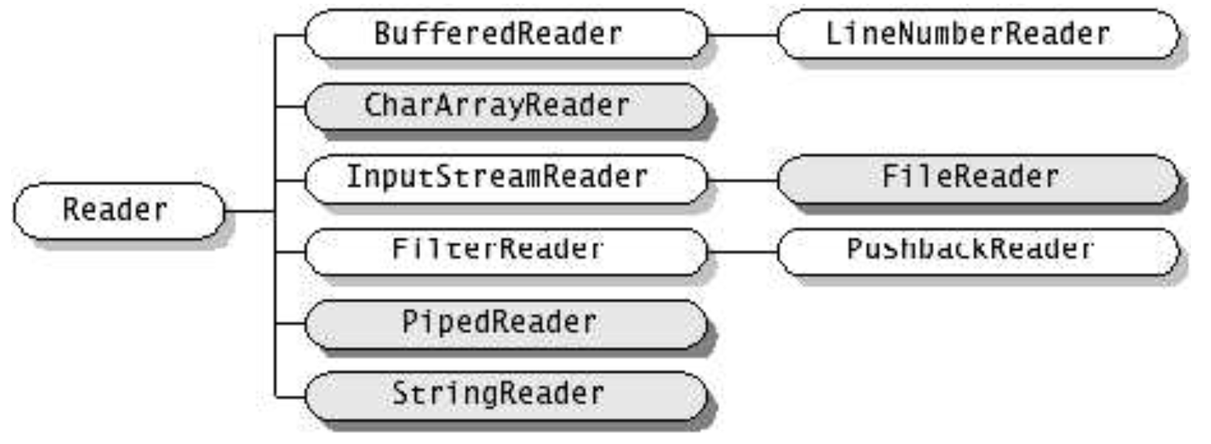
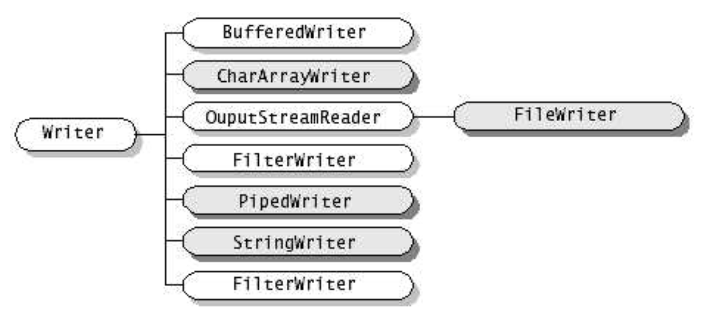
Reader and Writer

Slide 11
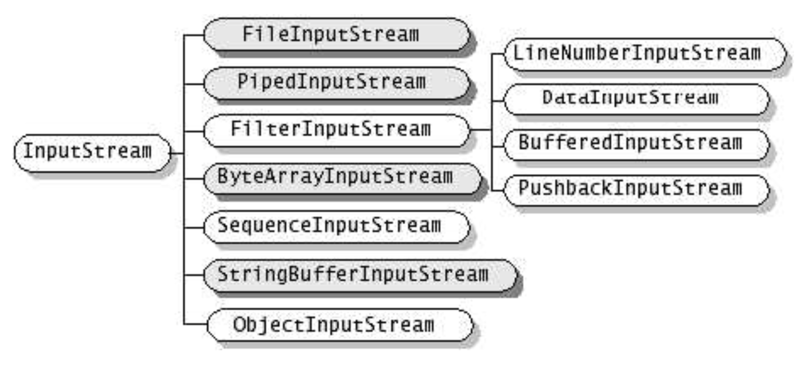
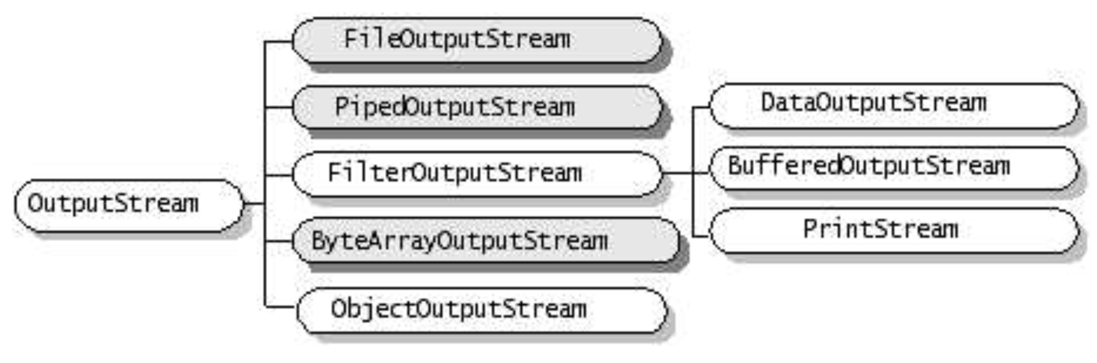
InputStream and OutputStream

Slide 12
Read/Write files
java.io.FileReader
java.io.FileWriter
R/W characters from files
java.io.FileInputStream
java.io.FileOutputStream
R/W bytes from files
java.io.File
represents filename and pathname

Slide 13
Read/Write pipes
java.io.PipedReader
java.io.PipedWriter
R/W chars from pipes
java.io.PipedInputStream
java.io.PipedOutputStream
R/W bytes from pipes

Slide 14
Read/Write in memory
java.io.CharArrayReader
java.io.CharArrayWriter
R/W chars from/to arrays of chars
java.io.StringReader
java.io.StringWriter
R/W chars from/to Strings
java.io.ByteArrayInputStream
java.io.ByteArrayOutputStream
R/W bytes from/to arrays of bytes

Slide 15
Buffered Streams
Buffered streams add buffering functionality to ordinary streams.
An explicit alternative to buffered streams is the use of read(int[] buf) or read(char[] buf).
BufferedInputStream
BufferedOutputStream
BufferedReader
BufferedWriter
Examples:
BufferedInputStream(InputStream i)
BufferedOutputStream(OutputStream o)
BufferedReader(Reader r)
BufferedWriter(Writer w)

Slide 16
Interpreted Streams
Translate primitive types in standard format (UTF-8) on a stream
DataInputStream(InputStream i)
readByte(), readChar(), readDouble(), readFloat(), readInt(), readLong(), readShort()
DataOutputStream(OutputStream o)
writeByte(), writeChar(), writeDouble(), writeFloat(), writeInt(), writeLong(), writeShort()

Slide 17
java.nio.file.Files
This class consists exclusively of static methods for manipulating files or directories (copy, move, delete, rename, set ownership, set attributes)
In most cases, the methods defined here delegate to the associated file system provider to perform actual operations.

Slide 18
java.util.StringTokenizer
StringTokenizer
Divides a String in tokens (using delimiters)
Blank is the default delimiter
Does not distinguish identifiers, numbers, comments, quoted strings
StreamTokenizer
Divides a Stream in tokens
More sophisticated, recognizes identifiers, comments, quoted string, numbers
Use symbol table and flags

Slide 19
Serialization
Objects can be permanently stored in many structured ways (character files, binary files, DBMS)
Read / write of an object imply:
read/write type and attributes of the object
Correctly separating different elements
When reading, create an object and set all attributes values
These operations (serialization) can be automated - for binary files - with specific classes:
ObjectInputStream
ObjectOutputStream

Slide 20
Serialization
Methods to read/write objects are:
void writeObject(Object)
Object readObject()
ONLY classes implementing the Serializable interface can be serialized.
Serializable is an empty interface. It is used to avoid serialization of objects without the permission of the class developer

Slide 21
Serialization (deep copy, no duplicates)
An ObjectOutputStream saves automatically all objects referred by its attributes (deep copy)
objects serialized are numbered in the stream
references are saved like ordering numbers in the stream
If I save 2 objects pointing to a third one, this is saved just once
Before saving an object, ObjectOutputStream checks if it has not been already saved
Otherwise it saves just the reference (as a number)

Slide 22
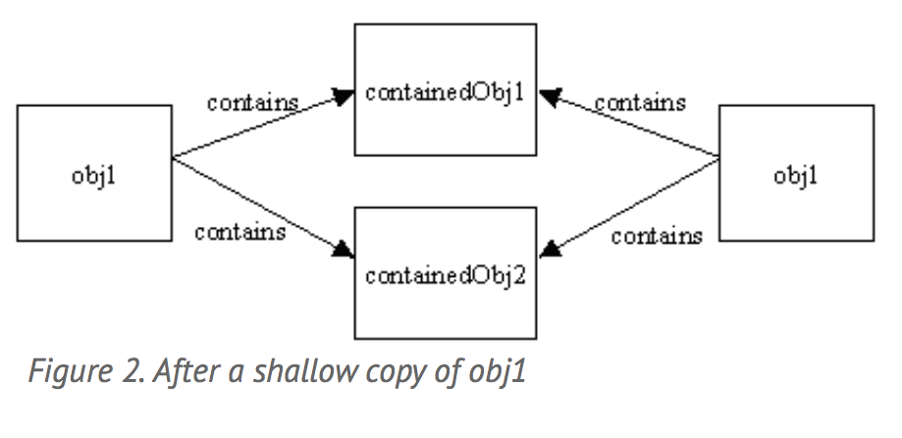
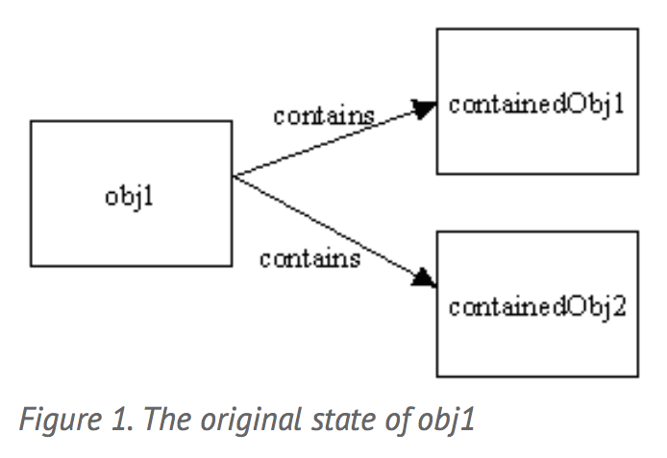
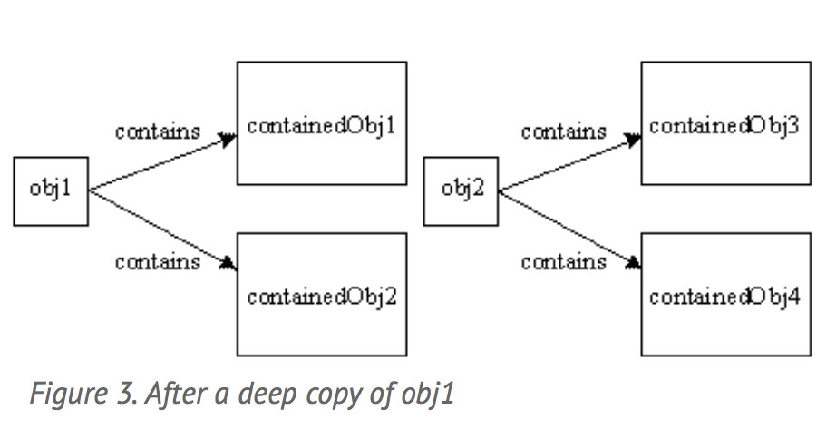
Deep and Shallow copies

Slide 23
Serialization, type recovery
When reading, an object is created
... but which is its type?
Down casting to the exact type is useful only to send specific messages
A viable solution could be down casting to a common ancestor

